Slide 1
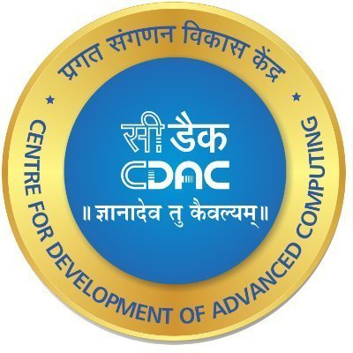
RHEL7,8 and 9
Life Cycle and Comparison
Ankush Kapoor
Project Engineer
HPC-Tech

Slide 2
RHEL Comparison
Link: My_RHEL_Documentation.docx

Slide 3
RHEL Life cycle
The Red Hat Enterprise Linux (RHEL) life cycle consists of several phases that outline the support and maintenance provided by Red Hat for each versions of operating system.
These phases define the availability of updates, bug fixes and security patches, as well as the level of support offered to customers.

Slide 4
RHEL Life cycle Phases :
1. Full Support Phase :
This phase begins when a major version of RHEL is released and lasts for a defined period, usually around 10 years.
During this phase, Red Hat provides regular maintenance updates, bug fixes, security patches and feature enhancements. Customers with active subscriptions receive full support and access to these updates.

Slide 5
RHEL Life cycle Phases :
2. Maintenance Support Phase:
After the full Support Phase ends or along with support phase, RHEL is in the maintenance Support Phase. During this Phase, which typically lasts for couple of years after version delivery.
Redhat continues to provide critical and selected non-critical security fixes. However new features and enhancements are not introduced in this phase.

Slide 6
RHEL Life cycle Phases :
3. Extended Life Phase :
Once the maintenance support phase concludes, RHEL enters the Extended Life Phase. This phase typically lasts for a few more years and is designed to provide customers with extended support options.
RedHat offers limited support during this phase, focusing primarily on critical security fixes and selected urgent bug fixes.

Slide 7
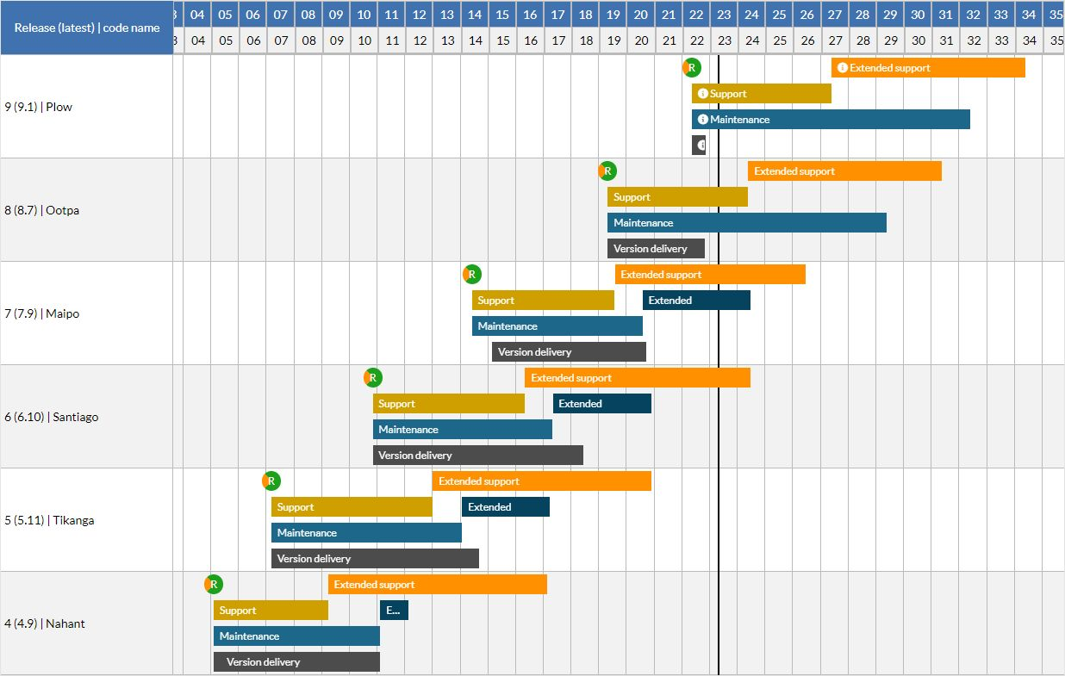
Reference Figure: Release, patch and end-of-life cycle of product Red Hat Enterprise Linux (Red Hat)

Slide 8
RHEL Life cycle Phases :
4. ELS (Extended Life Support) {Additional}:
After the Extended Life Phase, Red Hat may offer an extended Life Support (ELS) option for specific versions of RHEL. The ELS phase provides customers with an extended period of support beyond the normal life cycle. The level of support and the duration of the ELS phase can vary depending on the specific version and subscriptions.

Slide 9
THANK YOU

